Slide 1

Analysis of Protein Structure Prediction for cause of Glucagonoma and its effect when hDAT drug is introduced to it using PyMOL

Slide 2
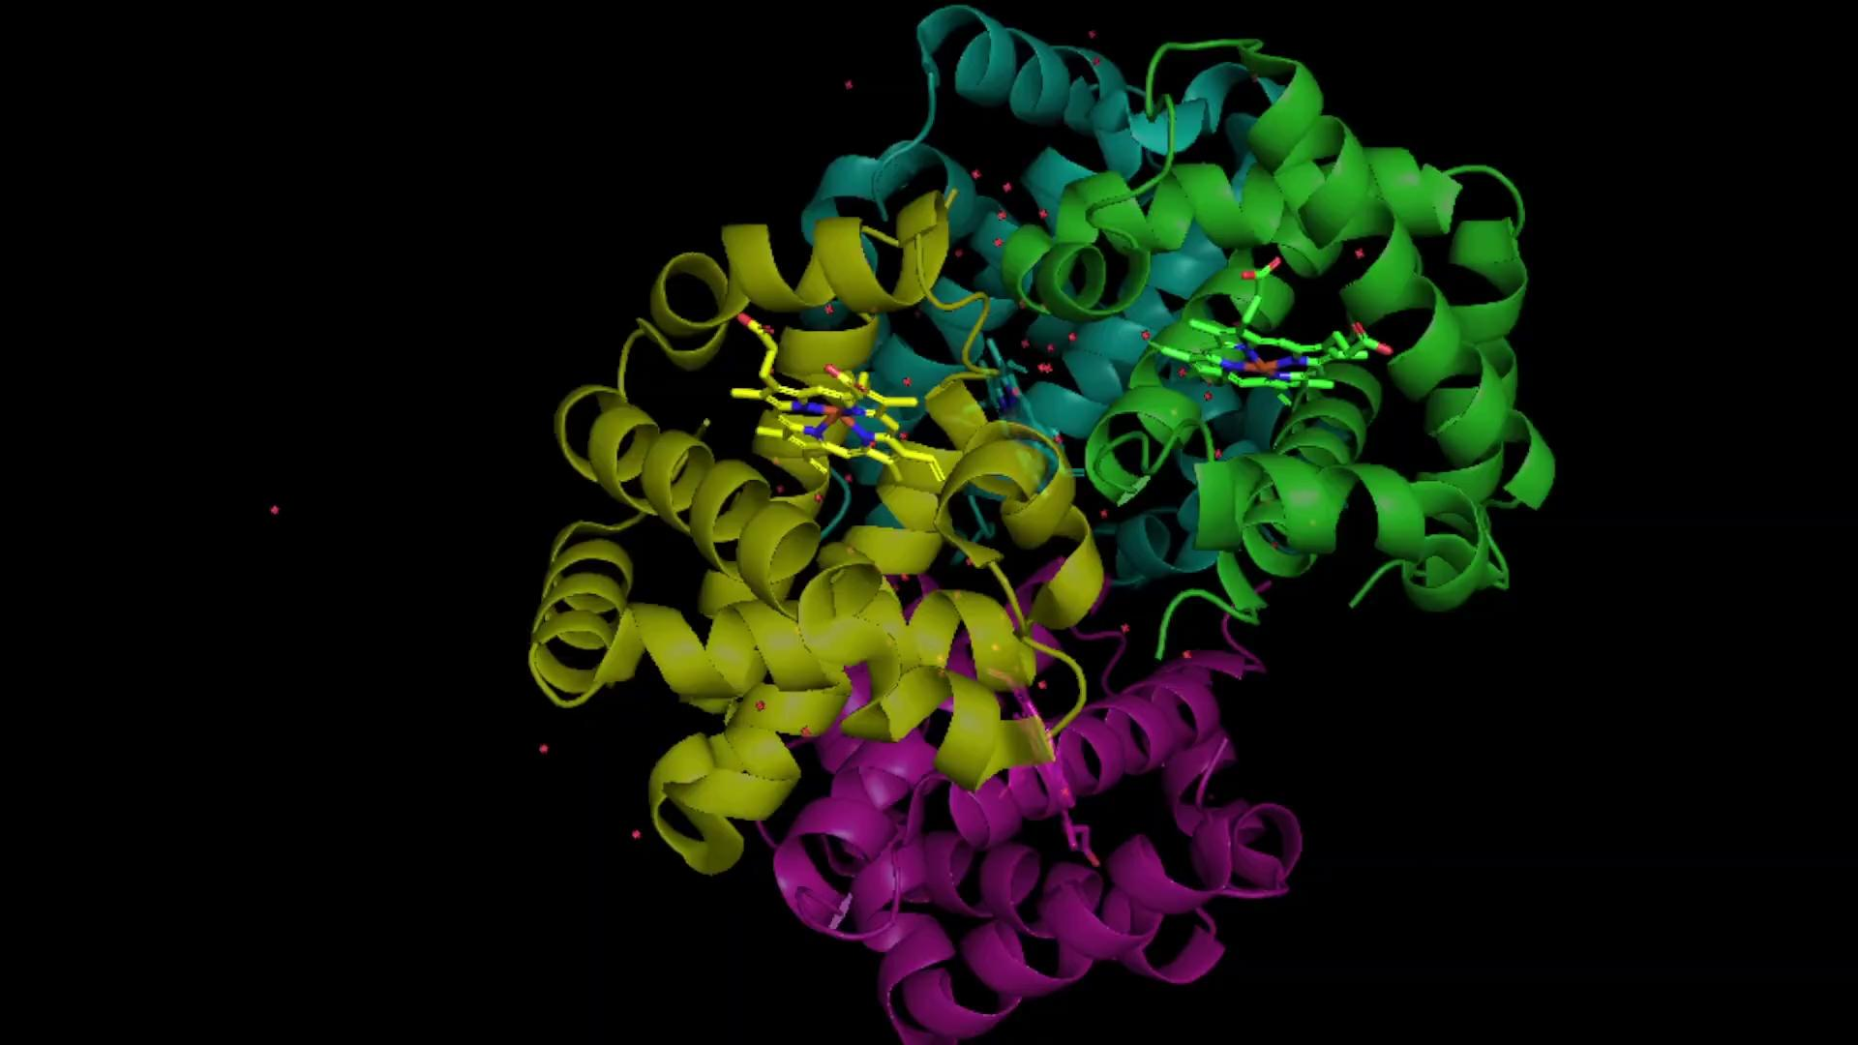
Human Glucagon (PDB Code : 1hga)
Glucagon primary role is to increase blood glucose levels by promoting the release of glucose from the liver.
It contains 4 polypeptide chains A, B, C, D

Slide 3
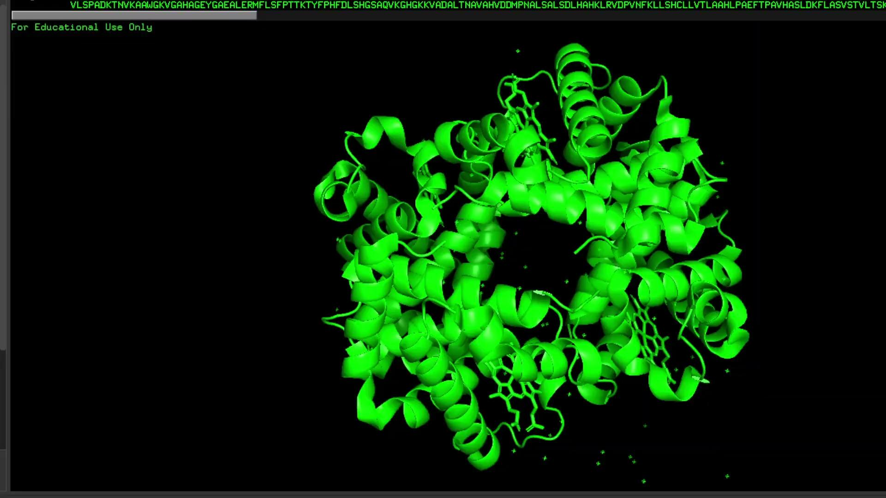
Important Residues in Glucagon
Leucine 45 and Phenylalanine 54 - These residues in the hormone interface play a role in binding to the receptor.
Glutamate 174 and Lysine 172 - Important for hydrogen bonding, they contribute to the stability of the hormone-receptor interaction.
Aspartate 171 and Lysine 168 - Form salt bridges that stabilize the hormone-receptor interface.
Tyrosine 42 and Histidine 18 - Involved in hydrophobic interactions that anchor the hormone to its receptor.

Slide 4
Glucagonoma
Glucagonoma is a rare type of pancreatic neuroendocrine tumor that results in the overproduction of glucagon, a hormone normally produced by the alpha cells of the pancreas.
The overproduction of glucagon leads to several metabolic disturbances, primarily hyperglycemia (high blood sugar), which can result in diabetes.

Slide 5
Symptoms of Glucagonoma
Diabetes: Due to elevated glucagon levels, patients often develop diabetes, which can be severe and difficult to control.
Necrolytic Migratory Erythema (NME): This is a characteristic skin rash seen in most patients. It presents as erythematous, blistering lesions that often start on the face, groin, and perineum and can spread to the rest of the body.
Weight Loss: Unintentional weight loss is common due to both the metabolic effects of glucagon and the presence of diabetes.
Glossitis: Inflammation of the tongue, leading to soreness and changes in appearance.
Anemia: Low red blood cell count can occur due to the metabolic disturbances and malnutrition.

Slide 6
Cause of Glucagonoma
GLP-1 receptor (1L6X) generally works to reduce blood glucose by stimulating insulin secretion and inhibiting glucagon release.
Glucagon receptor (1K2B) works to raise blood glucose by stimulating glycogen breakdown and glucose release.
Glycogen metabolism is tightly regulated by both systems, and disruption of this balance (e.g., in glucagonoma) can lead to excessive glucose release, contributing to hyperglycemia.

Slide 7
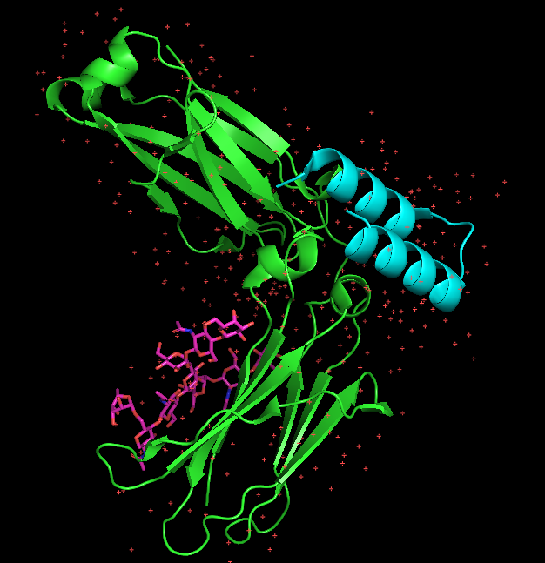
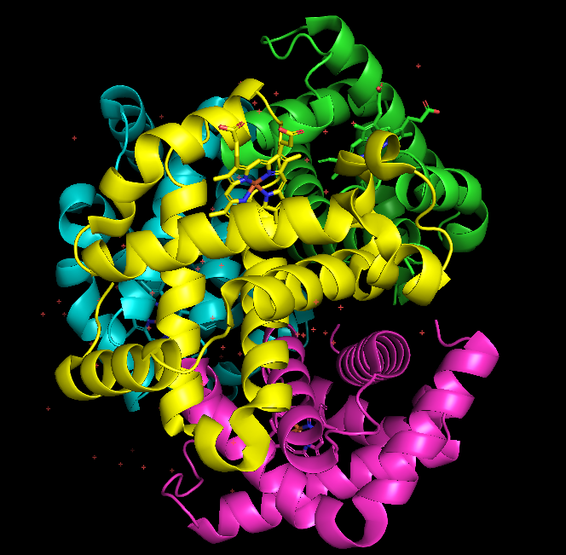
Differences between 1hga & 1l6x
GLP-1R (1L6X) and GCGR (1HGA) bind to different ligands (GLP-1 vs. glucagon).
GLP-1R primarily influences insulin secretion and glucose uptake, whereas GCGR primarily increases blood glucose through glycogen breakdown and glucose production.
They are distinct receptors, although both are involved in the regulation of blood glucose, but with opposite effects.
So, 1L6X (GLP-1R) is not part of 1HGA (glucagon receptor)—they are separate and distinct proteins/receptors with different functions related to glucose metabolism.
V/S
1L6X
1HGA

Slide 8
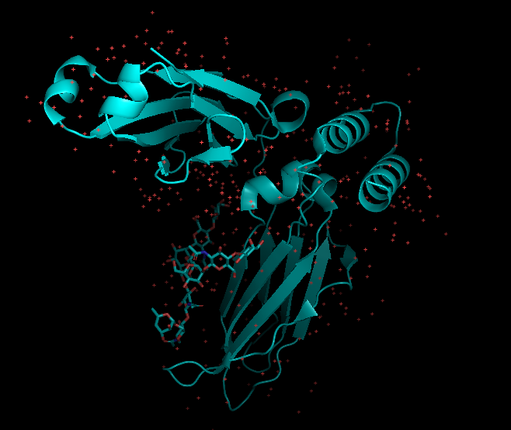
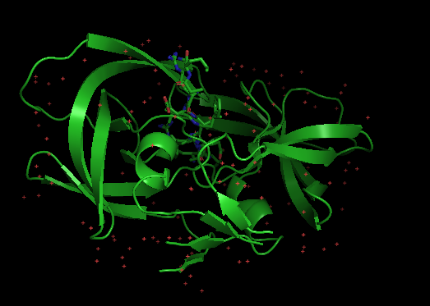
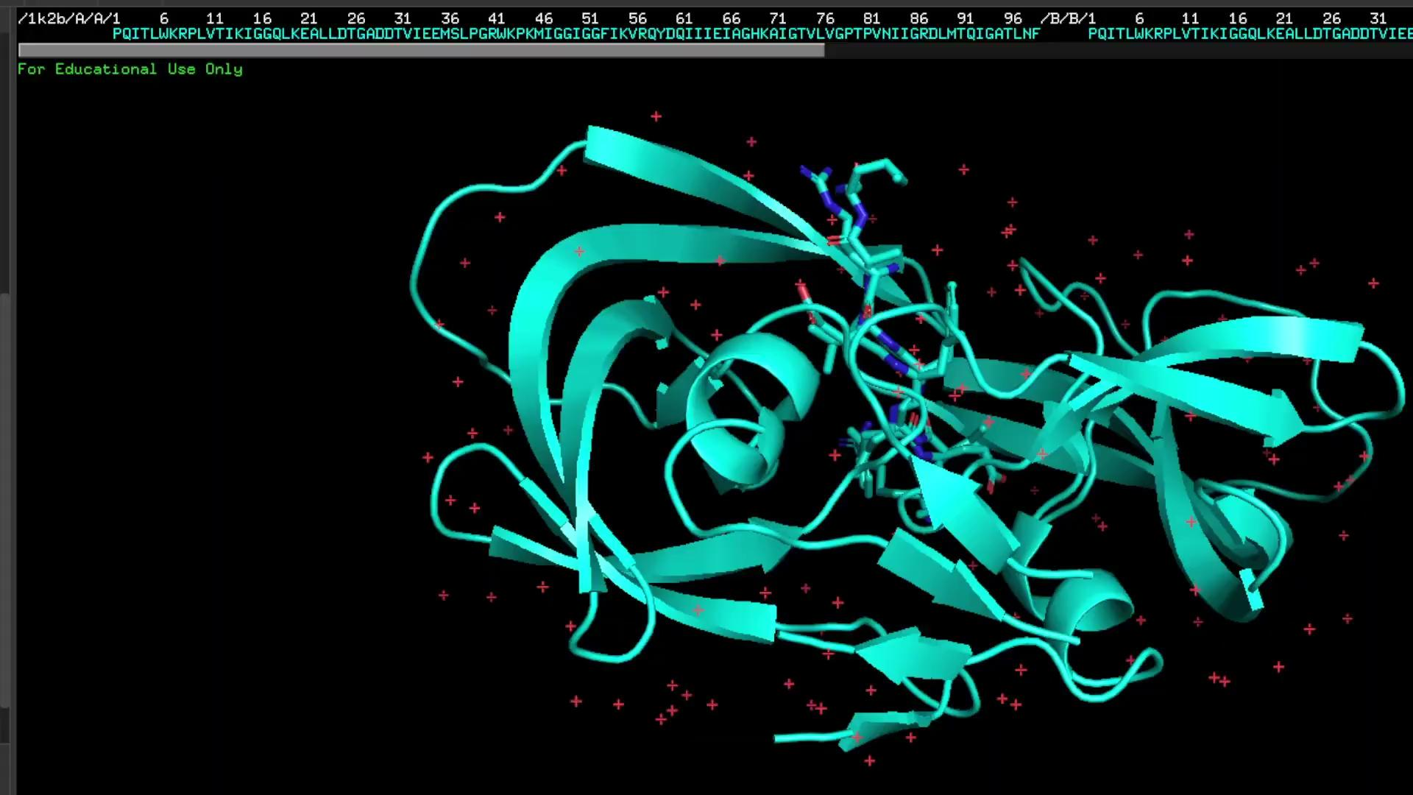

Potential Interaction Between 1L6X and 1K2B:
Given that 1L6X involves the IL-6 receptor and 1K2B involves the IL-2 receptor, these two proteins could have functional overlap in immune signaling pathways. Both IL-2 and IL-6 play important roles in immune system regulation, and their receptors are involved in T-cell activation and differentiation.
IL-6 and IL-2 can have synergistic or antagonistic effects in immune responses. For example, IL-6 promotes inflammation and the differentiation of B-cells, while IL-2 is crucial for T-cell growth and survival.
IL-6R (1L6X) and IL-2Rα (1K2B) may interact through shared immune signaling pathways or in the context of diseases where both cytokines play a role, like autoimmune disorders, cancers, or chronic inflammation.
+

Slide 9
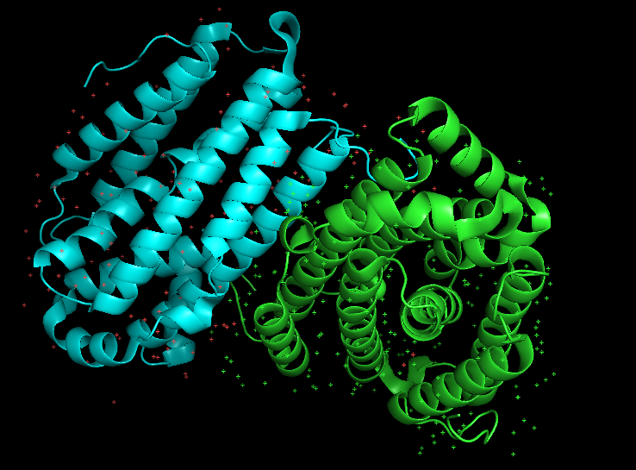
Drug 4A5D (Crystal structure of UGT1A1)
The term 4A5D refers to the crystal structure of UGT1A1, which was determined using X-ray crystallography. The crystal structure helps scientists understand how this enzyme interacts with substrates and drugs at the molecular level. By knowing the exact structure, researchers can study how different molecules fit into the enzyme’s active site, which can guide the design of drugs that are either more efficiently metabolized or less prone to drug interactions.
This is especially relevant when studying the pharmacokinetics (absorption, distribution, metabolism, and excretion) of drugs used in glucagonoma treatment.

Slide 10
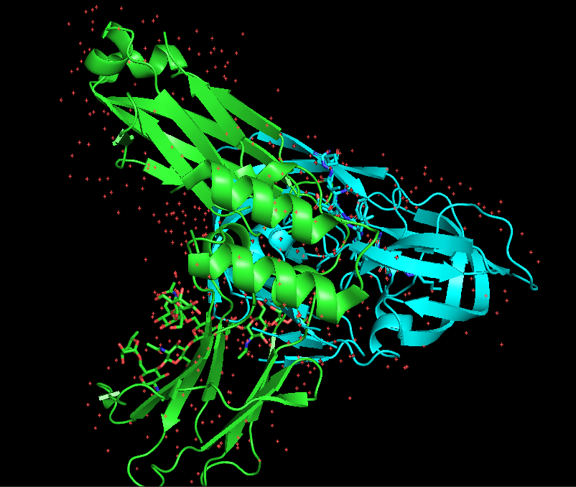
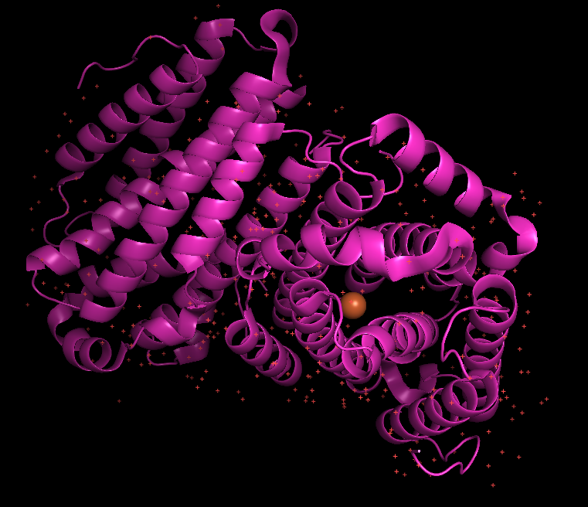
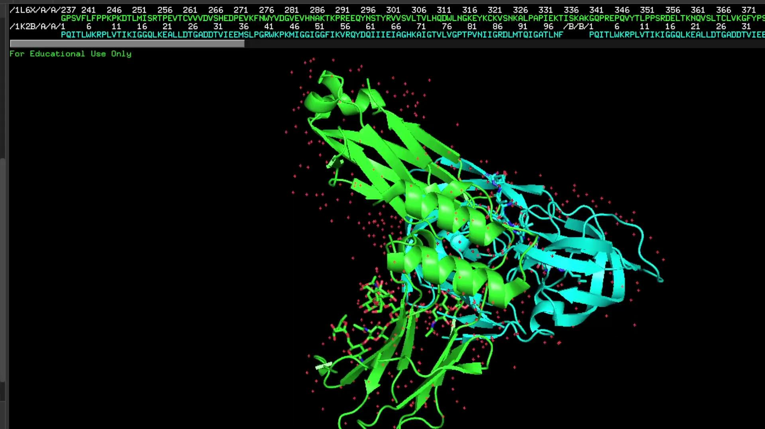
4A5D treatment for glucagonoma
The 4A5D structure itself does not treat glucagonoma, but it plays an important role in understanding how drugs, particularly those used in glucagonoma treatment, are metabolized in the body.
For drug injection, we are using Pymine library
+
1k2b + 1l6x
4a5d

